Slide 1
A Multi-Agent System for Nutritional Value Estimation
Roshan Kandel
Georgia State University
Project Advisor:
Dr. Hemanth Demakethepalli Venkateswara

Slide 2
Introduction/Motivation
People struggle to document food intake
Manual nutrition logging is time consuming and can be inaccurate
Existing systems require large supervised datasets
Need for automated, interpretable, interactive systems
Question: Can L:LMs perform zero shot nutrition estimation?

Slide 3
Problem statement
Given a single food image, estimate:
Dish name
Ingredients
Portion sizes
Calories and macronutrients

Slide 4
Limitations to prior work
lm2Calories: needs menu priors
portion3D: requires depth
DPF-Nutrition: complex supervised training
Ingredient detectors: require fixed vocabularies
Not much explainability or follow-up queries

Slide 5
Proposed solution: multi-agent llm pipeline
4 core agents
Dish Agent
Ingredient Agent
Quantity Agent
Nutrition Agent
Zero training (zero shot)
LangGraph Orchestration
Schema constrained JSON
LLM reasoning and vision

Slide 6
AGENT ROLES
Dish Agent: finds the name of dish, cuisine
Ingredient Agent: open vocabulary ingredients
Quantity Agent: estimates the total grams
Nutrition Agent: Computes calories and macronutrients

Slide 7
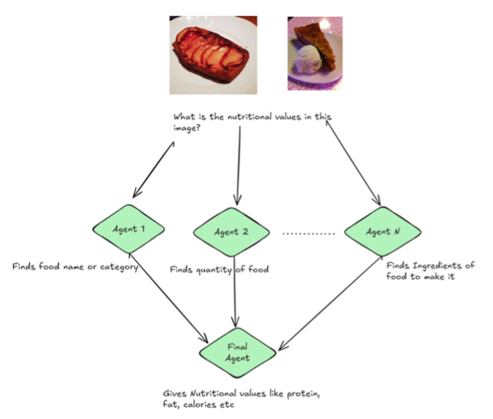
Architecture

Slide 8
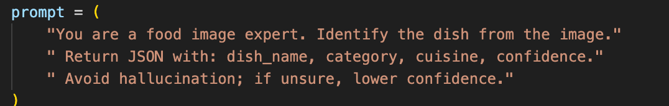
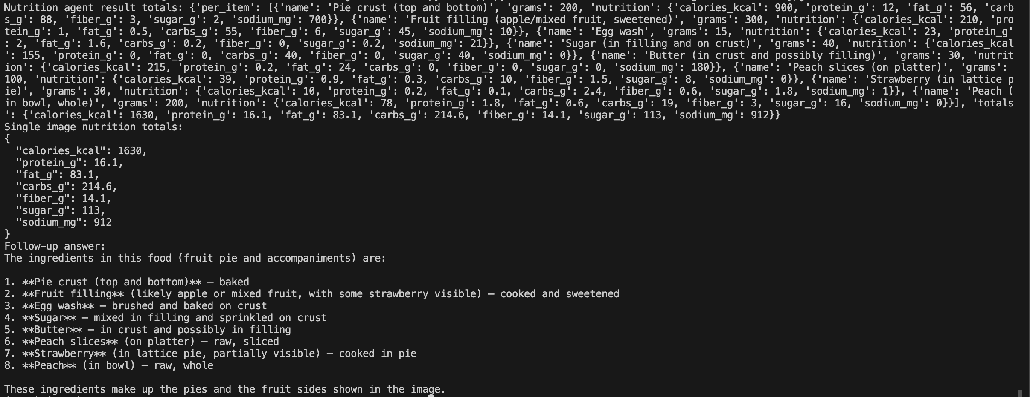
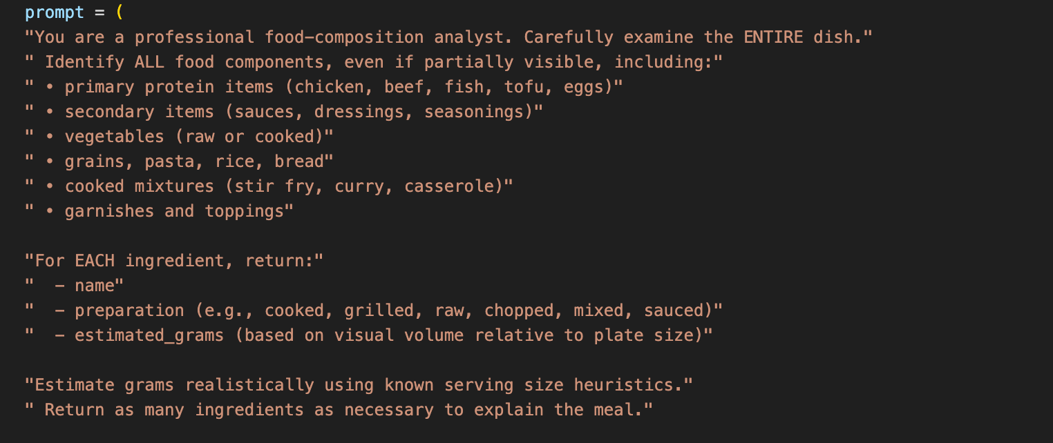
Agent prompt design
Each agent is guided by a concise and role specific prompt
Output is forced into strict JSON
Schema Based constraints prevent hallucination

Slide 9
Dataset (Nutrition5k)
5000 real dishes in a cafeteria setup
Chemically measured nutrients
Per-ingredient grams
It has RGB + depth but we only use the RGB images (zero shot)
3490 images extracted for evaluation

Slide 10
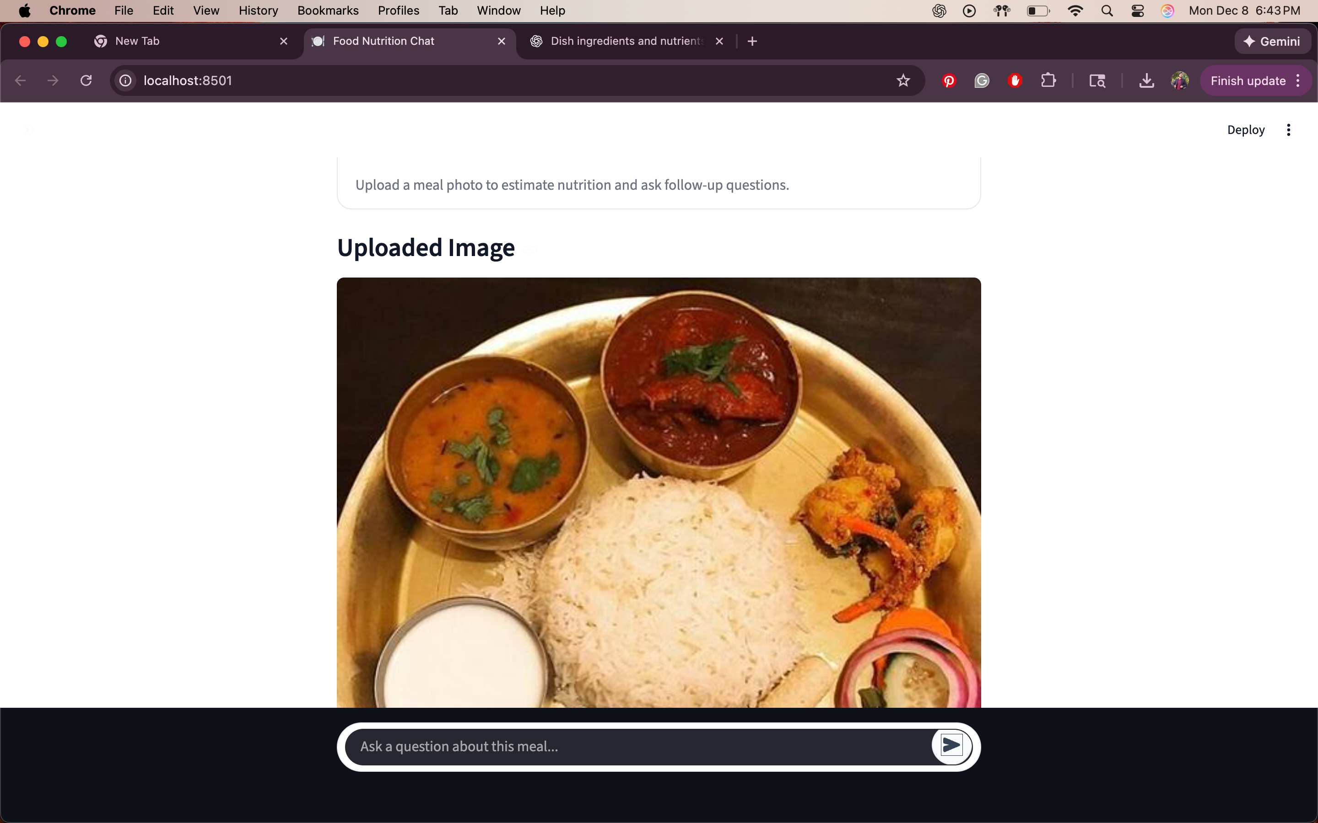
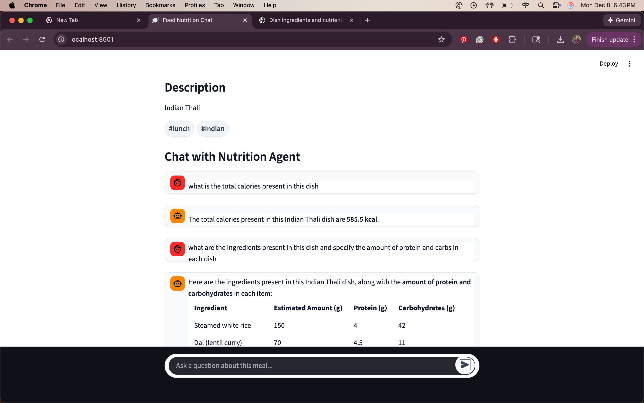
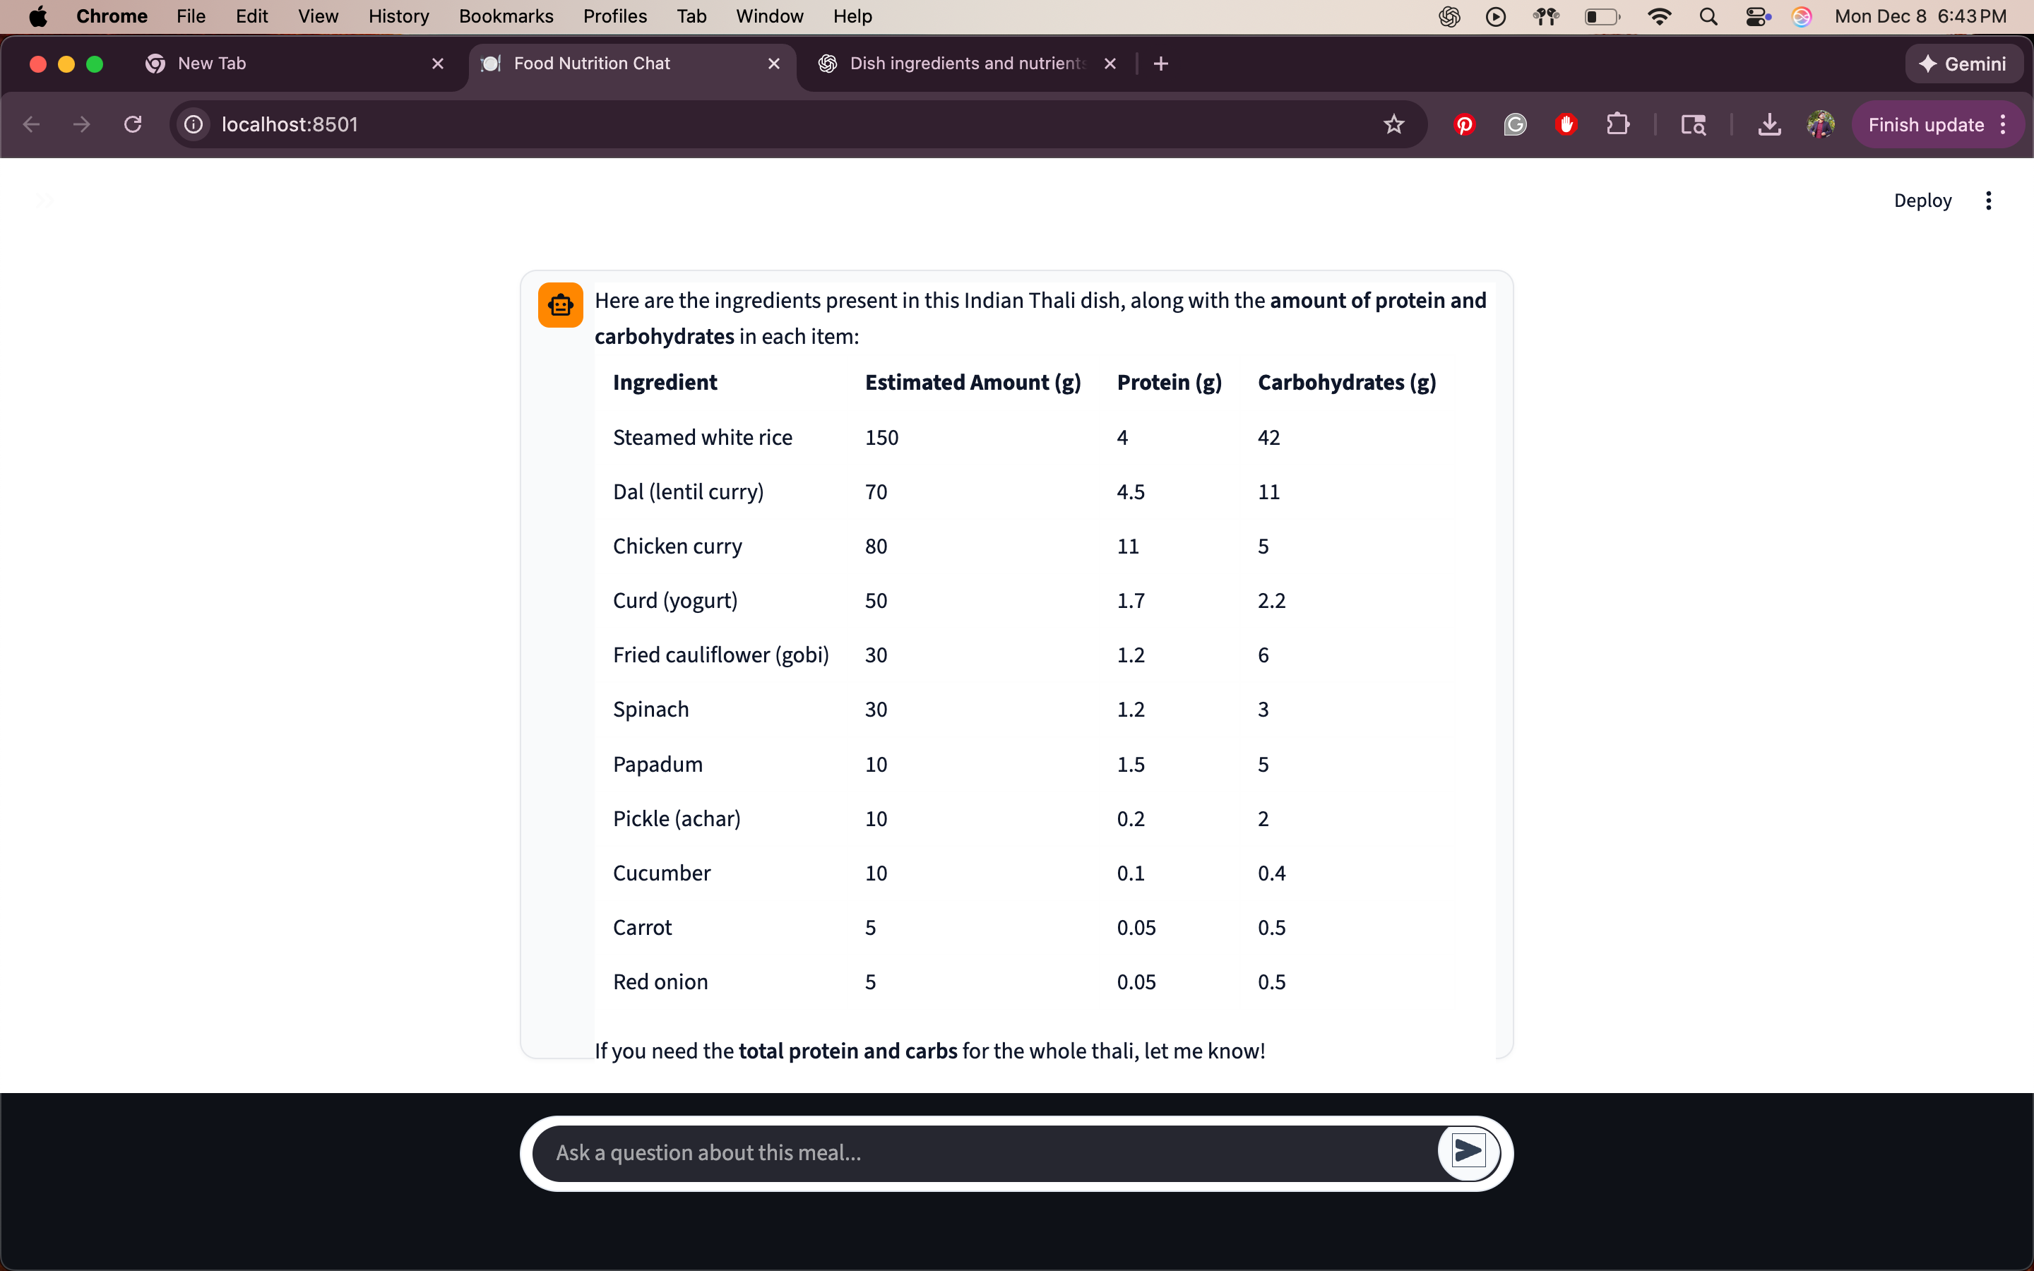
STREAMLIT (DEMO)

Slide 11
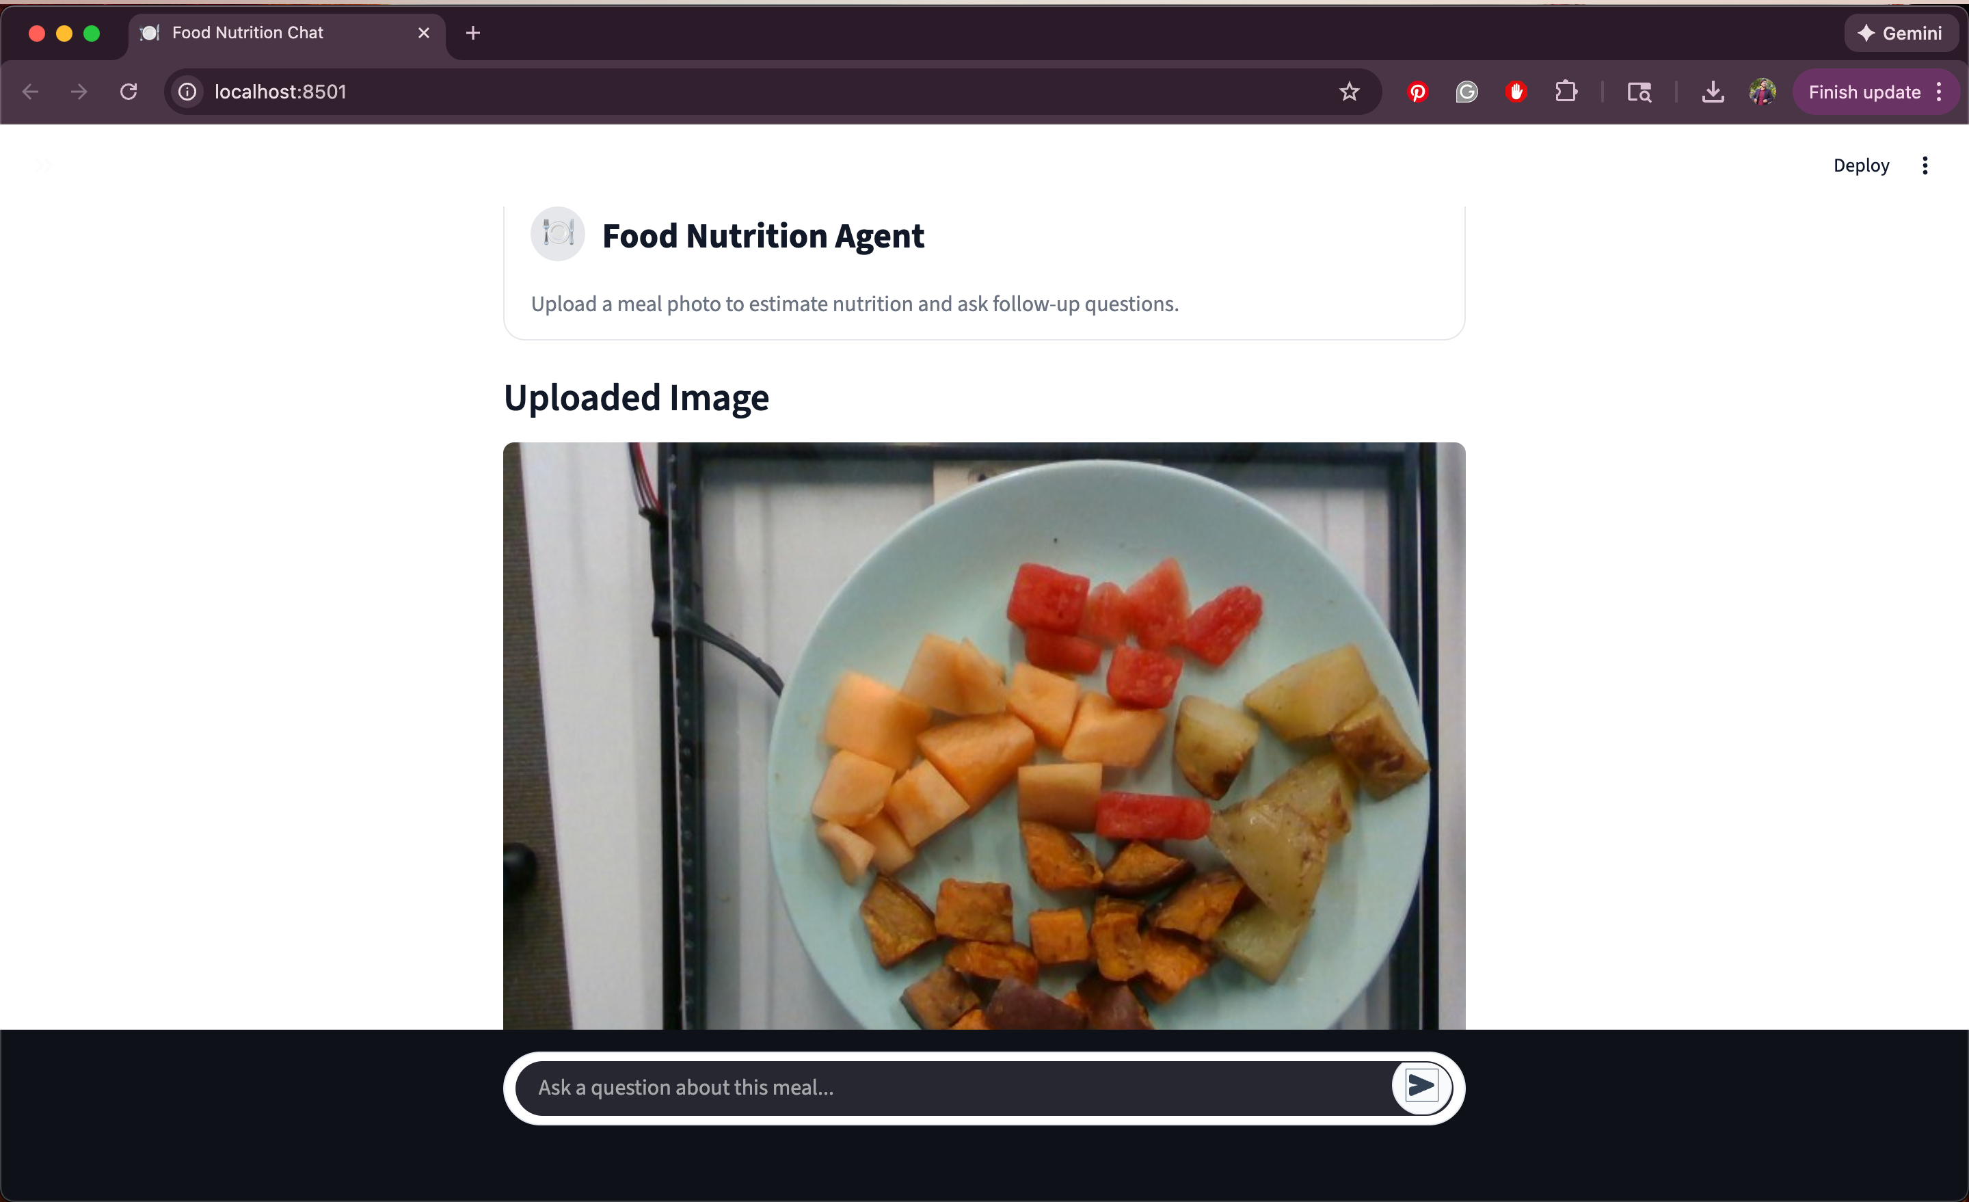
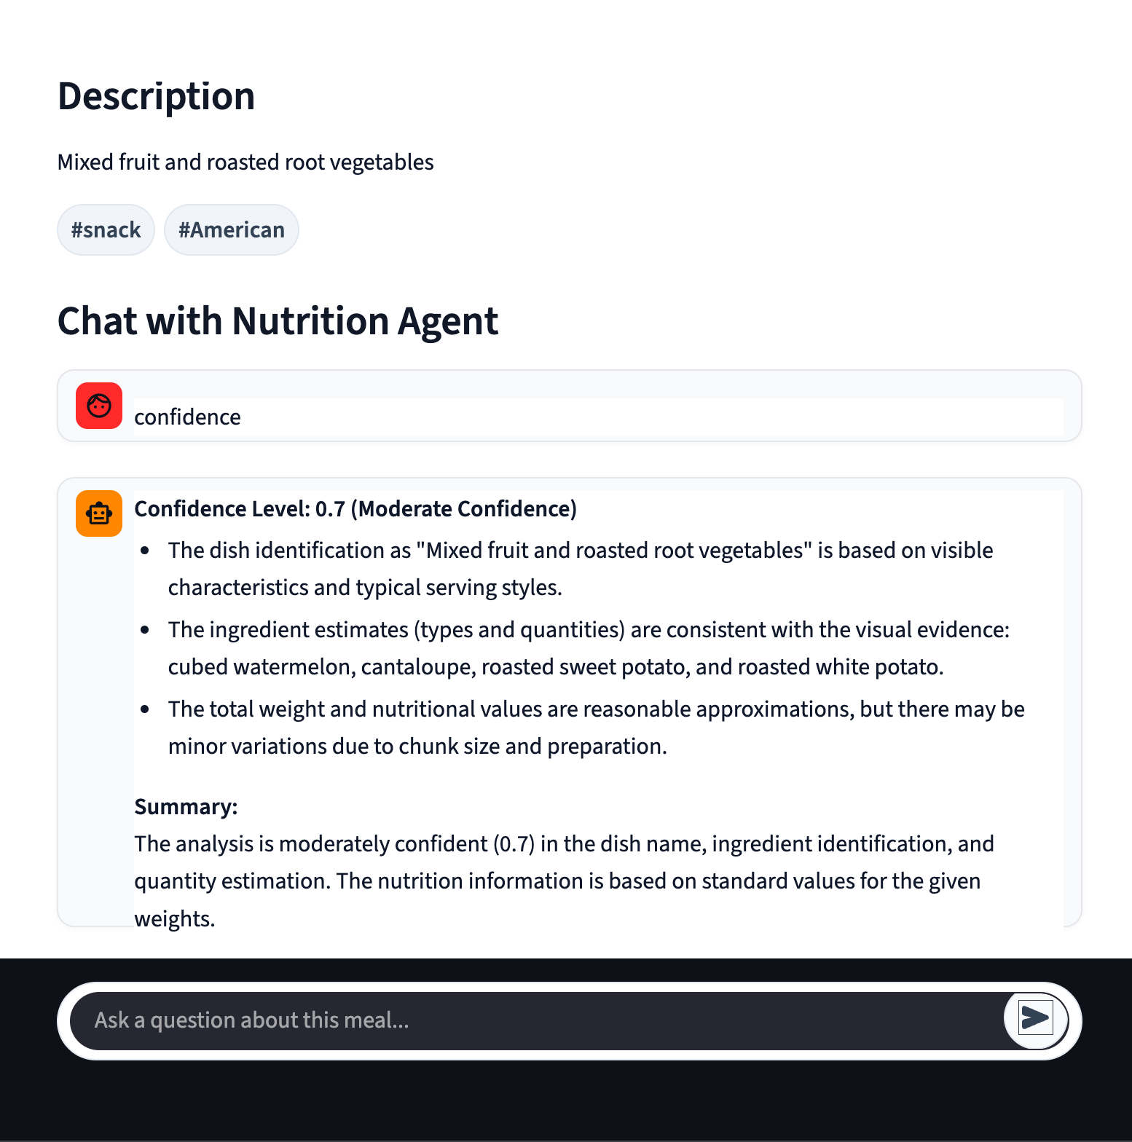
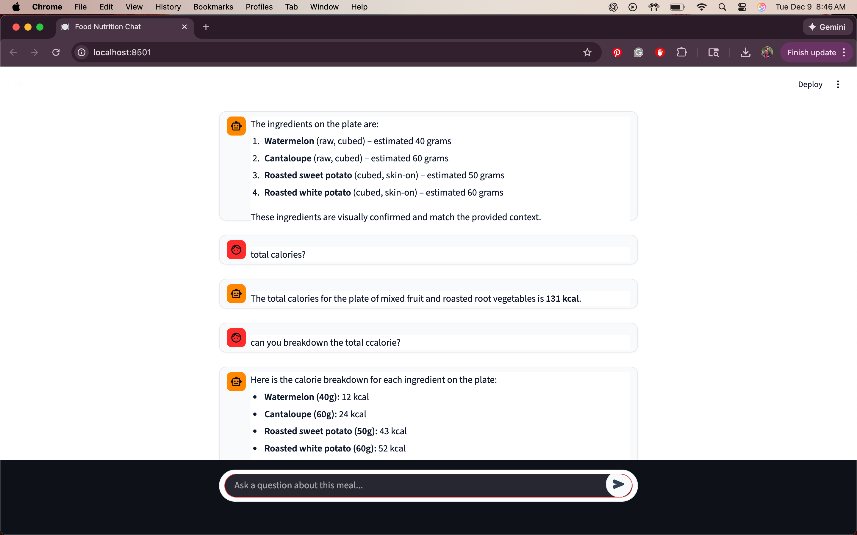
STREAMLIT (DEMO)

Slide 12
Evaluation metrics
Mean Absolute Error (MAE)
Root Mean Squared Error (RMSE)
Accuracy Score

Slide 13
Results
Calories MAE ~ 98 kcal
RMSE ~ 138 kcal
Protein MAE ~ 7.9g
Fat MAE ~ 6.5 g
Carbs MAE ~ 8.5 g
Accuracy ~ 64%

Slide 14
Baseline Comparison
lm2Calories: 143 kcal
DeepFood: 100-120 kcal
Portion3D: ~80 kcal
DPF Nutrition: 60-75 kcal
Ours: 98 kcal

Slide 15
Additional Qualitative CASES
Strong Success on simple foods like Bacon and Almonds
Partial success on mixed foods like mixed fruit plates
Failure on complex foods like curries and food platters

Slide 16
Qualitative Trends
Best on single-protein dishes
Hardest on mixed dishes (curries, stews, etc.)
LLM infers mass from context
Less variance on simple dishes

Slide 17
Strengths of the system
Zero shot performance
Fully interpretable
Modular, replaceable agents
Supports conversational queries
No dataset training required

Slide 18
Limitations
Lower accuracy than supervised models
No depth and hence portion uncertainty
Ingredient ambiguity
LLM latency and cost

Slide 19
Future Work
Hybrid CNN + LLM models
Add depth estimation
Fine tune LLM on some dataset
Add CNN segmentation for ingredients

Slide 20
Conclusion
Novel zero shot multi agent nutrition estimator
Interpretable and modular
Strong performance vs early baselines that still needed training
Foundation for future hybrid systems

Slide 21
THANK YOU

